Slide 1

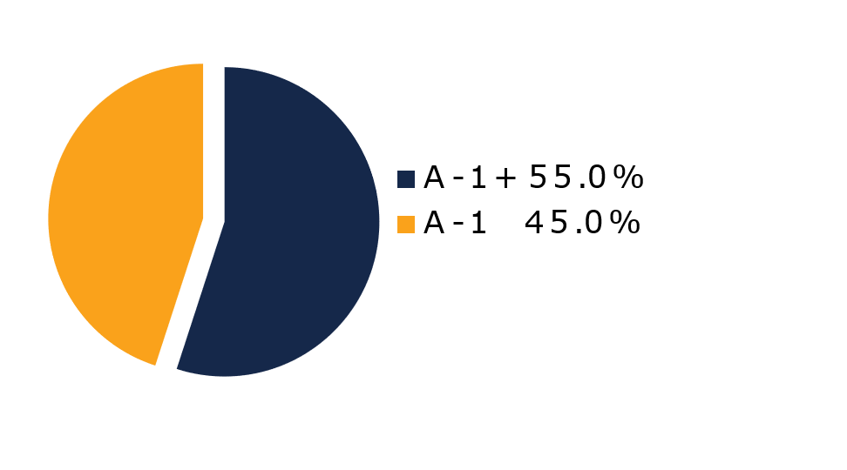
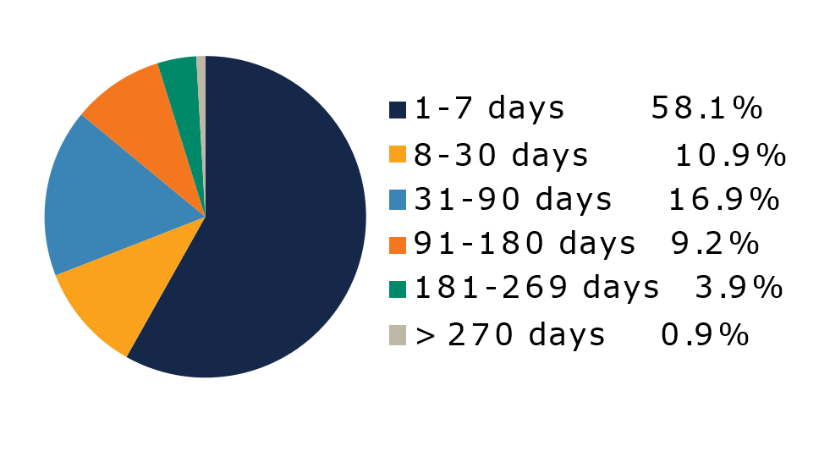
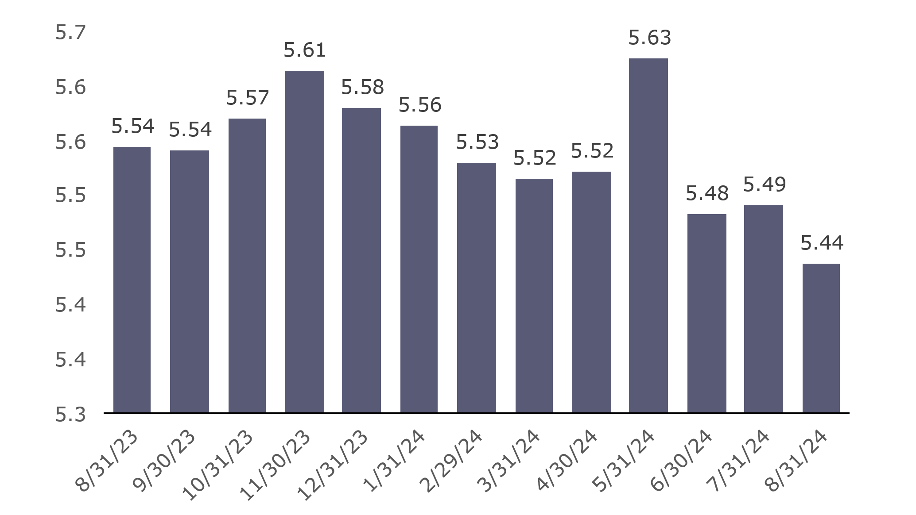
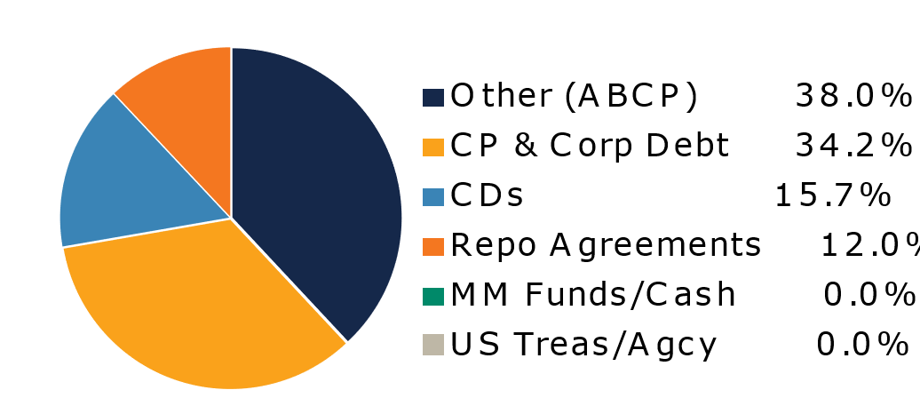
West Virginia Money Market Pool
Portfolio Overview as of 8/31/2024
Pool Assets
$9.6 billion
The West Virginia Money Market Pool is a money market portfolio created to invest the majority of the state and local government operating funds. The objective of the portfolio is to maintain sufficient liquidity to meet the needs of the participants while striving to earn a return above inflation. The risk factor is low and managed through numerous maturity restrictions, diversification, guidelines, and credit limits.
Pool Features and Benefits:
Professional management is provided by the West Virginia Board of Treasury investments’ staff and professional investment advisors (Federated Hermes and UBS Global Asset Management). Rated AAAm by Standard & Poor’s. Seeks to maintain a net asset value (NAV) of $1 per share. Investment yields are competitive with other money market accounts. Easy access is provided through the State Treasurer’s Office online system. Account can be opened for as little as $100 with no limit on the number of transactions. Contributions and withdrawals are allowed daily. Income is distributed on a daily basis.
7-Day Simple Money Market Yield (%)
To learn how to make the West Virginia Money Market Pool work for your cash investing needs call: 304-340-1564 or visit: wvbti.org
Portfolio holdings and composition are shown as of the date indicated. Since market conditions fluctuate suddenly and frequently, the portfolio holdings may change and this list is not indicative of future portfolio composition. These portfolio holdings are not intended to be and do not constitute recommendations that others buy, sell, or hold any of the securities listed. An investment in the Pool is not insured or guaranteed by any government or government agency. Although the manager of the Pool seeks to preserve principal, it is possible to lose money by depositing money in the Pool. A AAAm rating by Standard & Poor’s is obtained after S&P evaluates a number of factors, including credit quality, market price exposure and management. Ratings are subject to change and do not remove market risk.
Credit Quality Composition (%)
Maturity Schedule (%)
Portfolio Composition (%)
Weighted Average Maturity
38 Days
Top Holdings (%)

Slide 2
Board of Treasury Investments | Fact Sheet
Commentary
Here we go again
It should be no surprise when the financial markets get ahead of themselves. And we don’t need to be an expert at behavioral economics to know rational investors don’t exist. But that doesn’t make it any less frustrating when traders get over their skis, adding volatility and detracting from liquidity in the market. Just as they did late last year, markets are betting the Federal Reserve cuts rates faster than policymakers have indicated and, importantly, faster than the data is supporting.
Provoked by the Labor Department’s substantial downward revision of jobs added this past year and Chair Jerome Powell’s dovish comments at the Federal Reserve’s central bank symposium at Jackson Hole, Wyo., the futures market has increased the odds of a 50-basis point cut in September policy-setting meeting. We don’t agree, expecting a quarter-point reduction. The air is thinner near the Grand Tetons, but it’s the markets that seem to be affected by the altitude.
Case in point is that downgrade of the employment figure. The Dept. said that the economy added 818,000 fewer jobs over the past 12 months through March than it had reported. Because that is the largest downward revision since 2009, investors seem to be treating it as the mark of an imminent recession. But we have always felt the Fed is comfortable with monthly additions of around 150,000 jobs as it describes an economy growing at a reasonable pace. Well, the new average is 174,000—not as “red hot” as before the revision, but with a robustness still indicative of a soft landing.
While monetary policy works with a lag, the Fed likely views the labor market as supporting a soft landing, not a free fall. Like all policymakers, Powell engages in FedSpeak. But I’ve noticed over his tenure that when he says something clever or creative, it seems to represent his true thoughts. His address in Jackson Hole included this odd turn of phrase: “We do not seek or welcome further cooling in labor market conditions.” He is not panicking. In our minds, it would take an extraordinarily weak August payroll number combined with a large jump in the unemployment rate to shift our expectations from a quarter-point to a half-point cut at the September FOMC meeting. On the flip side, the data would have to be very strong to derail the Fed from easing at all. Inflation prints between now and then also are key, of course. Policymakers will have seen all three major government reports—July PCE and August CPI/PPI—before they meet Sept. 16-18, and the same logic applies.
Unfortunately for cash managers, the more investors infer, the more they interfere. The yield curve has now completely inverted. For those of us who expect at most 75 basis-points of cuts in the fed funds target range (now 5.25-5.5%) by year-end, it’s hard to rationalize buying securities offering the corresponding deflated yields.

