Slide 1

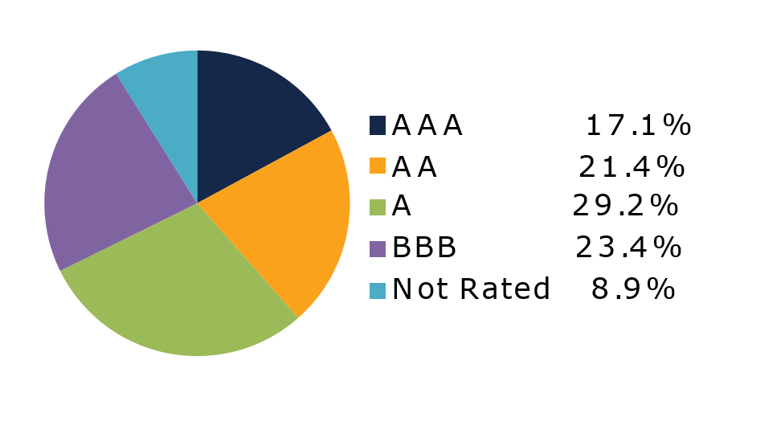
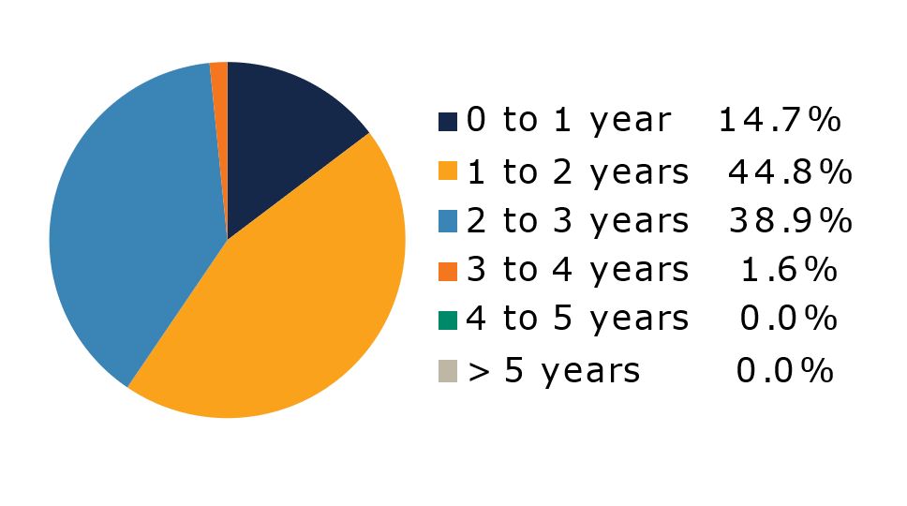
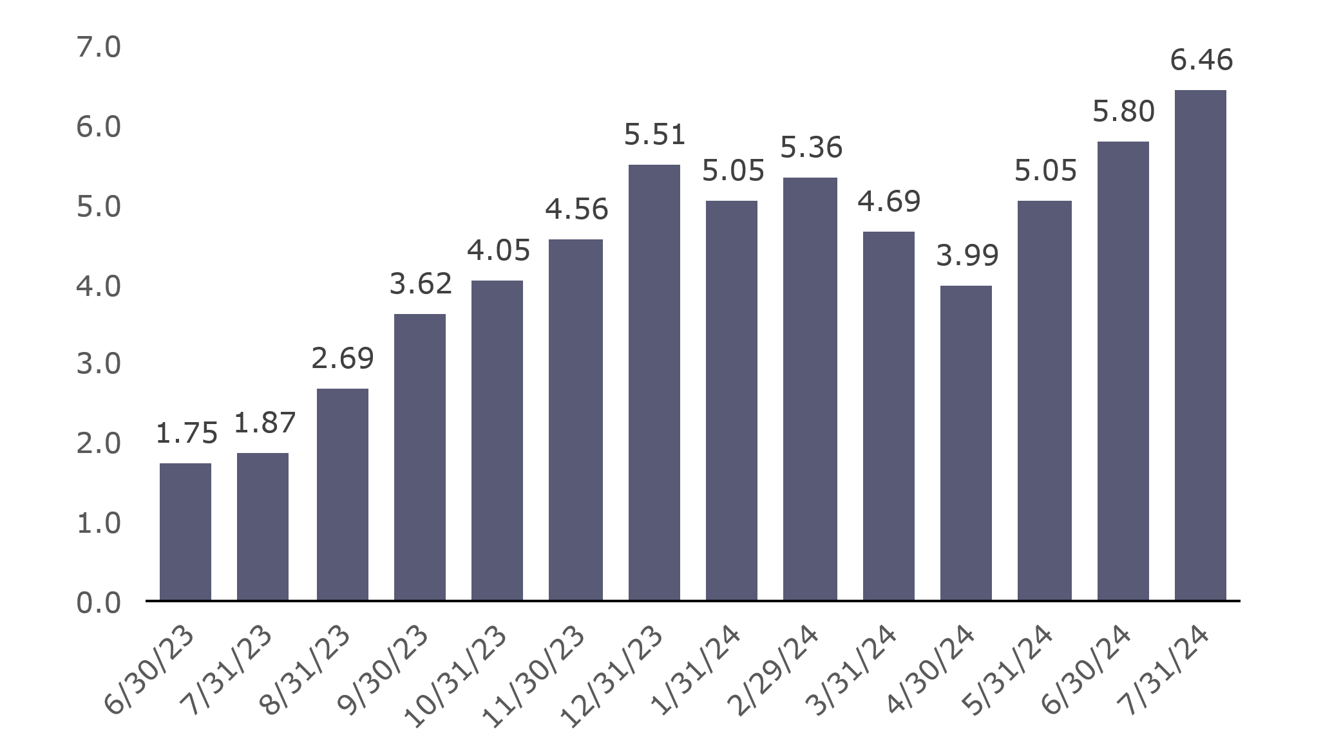
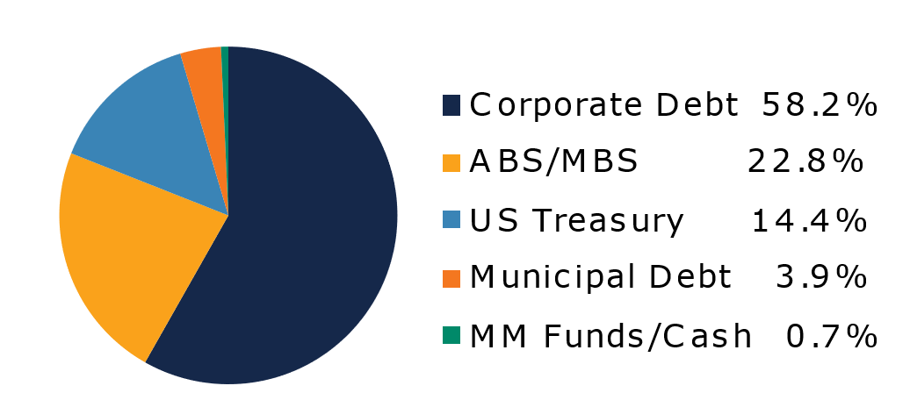
West Virginia
Short Term Bond Pool
Portfolio Overview as of 7/31/2024
Pool Assets
$690 million
The West Virginia Short Term Bond Pool was created to invest restricted moneys of participants which have a longer-term investment horizon. The objective of the portfolio is to earn an incremental return over the WV Money Market Pool with an objective of asset growth rather than current income. The risk factor is higher than the WV Money Market Pool and is managed through numerous maturity restrictions, diversification, guidelines, and credit limits.
Pool Features and Benefits:
Professional management is provided by the West Virginia Board of Treasury investments’ staff and professional investment advisor (Sterling Capital Management). Floating net asset value (NAV). Investment yields are competitive with other short duration fixed income pools. Easy access is provided through the State Treasurer’s Office online system. Account can be opened for as little as $100 with no limit on the number of transactions. Contributions and withdrawals are allowed monthly. Income is distributed on a monthly basis.
Return Summary
To learn how to make the West Virginia Short Term Bond Pool work for your cash investing needs call: 304-340-1564 or visit: wvbti.org
Portfolio holdings and composition are shown as of the date indicated. Since market conditions fluctuate suddenly and frequently, the portfolio holdings may change and this list is not indicative of future portfolio composition. These portfolio holdings are not intended to be and do not constitute recommendations that others buy, sell, or hold any of the securities listed. An investment in the Pool is not insured or guaranteed by any government or government agency and it is possible to lose money by depositing money in the Pool.
Credit Quality Composition (%)
Maturity Schedule (%)
Portfolio Composition (%)
Effective Duration
649 Days
Top Holdings (%)

Slide 2
Board of Treasury Investments | Fact Sheet
Commentary
A tumultuous month of July saw President Biden abandon his run for reelection, rising geopolitical tensions in the Middle East, and the beginnings of a stock market correction in response to some high-profile earnings misses. However, U.S. economic data again appeared to serve as the primary driver of movements in fixed income markets. The U.S. CPI showed that overall prices actually fell by 0.1% month-over-month in June while the CPI ex-food and energy rose just 0.1% month-over-month. The FOMC preferred measure of inflation, the PCE Index, showed a similar pattern of moderation in price increases. Meanwhile, the U.S. GDP report showed that the economy expanded at a healthy 2.8% annualized rate during the second quarter. While the jobless rate increased to 4.1%, employers added another 206K jobs in June. Despite the progress made on the inflation front and some concern about the rising unemployment rate, the FOMC opted not to cut the fed funds rate at their July 31 meeting but signaled an openness to cutting rates as soon as their September meeting. This was enough to move short-term interest rates sharply lower for the month, with the yield on the 2-year Treasury note closing 0.50% lower at 4.26%, its lowest level since February.
Corporate bonds appeared to remain above the fray during the month and performed well. While weakness in the equity market often bleeds into credit spreads, the option-adjusted spread on the ICE BofA 1-3Y U.S. Corporate Index tightened this month as the index outperformed duration-matched Treasuries by 0.13%. This can be largely explained by the low debt levels among many of the companies in the technology sector that led equity indices lower in July, as weaker earnings typically should not put a dent in leverage or credit ratings for most of these firms. While excess returns remained positive for most portions of the index, consumer-related industries and media underperformed while banks, capital goods and telecommunications companies outperformed.
The move lower in interest rates was a boon to agency mortgage-backed securities (MBS), which outperformed most other risky assets. The continued strength in the economy and overall demand for fixed income assets also boosted the performance of other securitized assets, including asset-backed securities (ABS) which outperformed Treasuries by 0.07% for the month. Commercial mortgage-backed securities (CMBS) fundamentals received a boost from the move lower in interest rates and turned in a similar performance.
The views expressed represent the opinions of Sterling Capital Management. Any type of investing involves risk and there are no guarantees that these methods will be successful. Data is as of 07.31.2024 unless otherwise stated. Source: Bloomberg L.P. Fed = Federal Reserve; FOMC = Federal Open Market Committee; CPI = Consumer Price Index; PCE = Personal Consumption Expenditure; GDP = Gross Domestic Product. Specific securities identified and described do not represent all of the securities purchased, sold or recommended to clients. There are no assurances that securities identified will be profitable investments. The securities described are neither a recommendation nor a solicitation.

