Slide 1

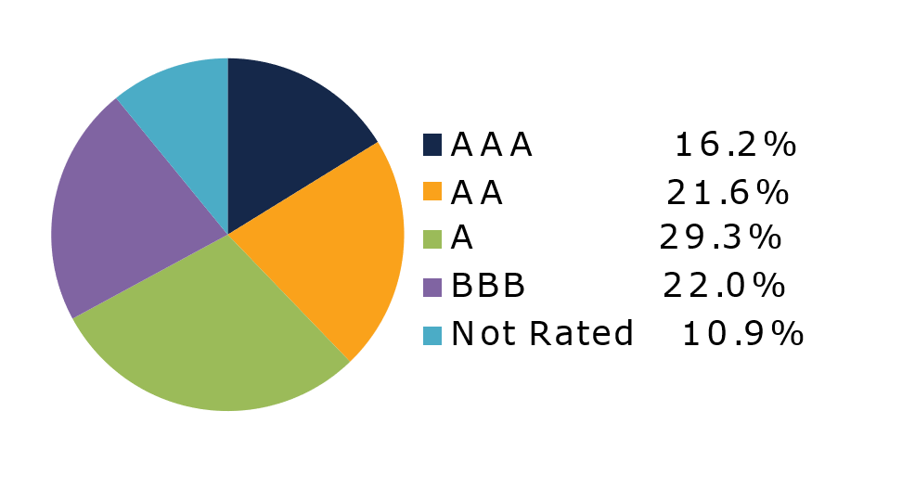
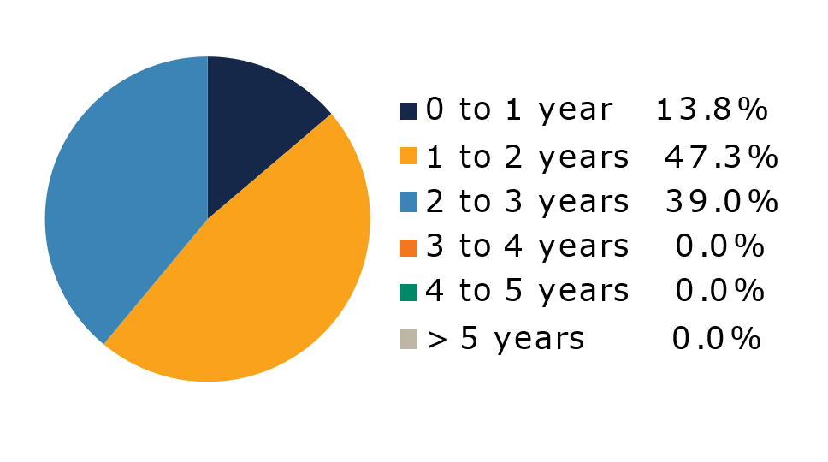
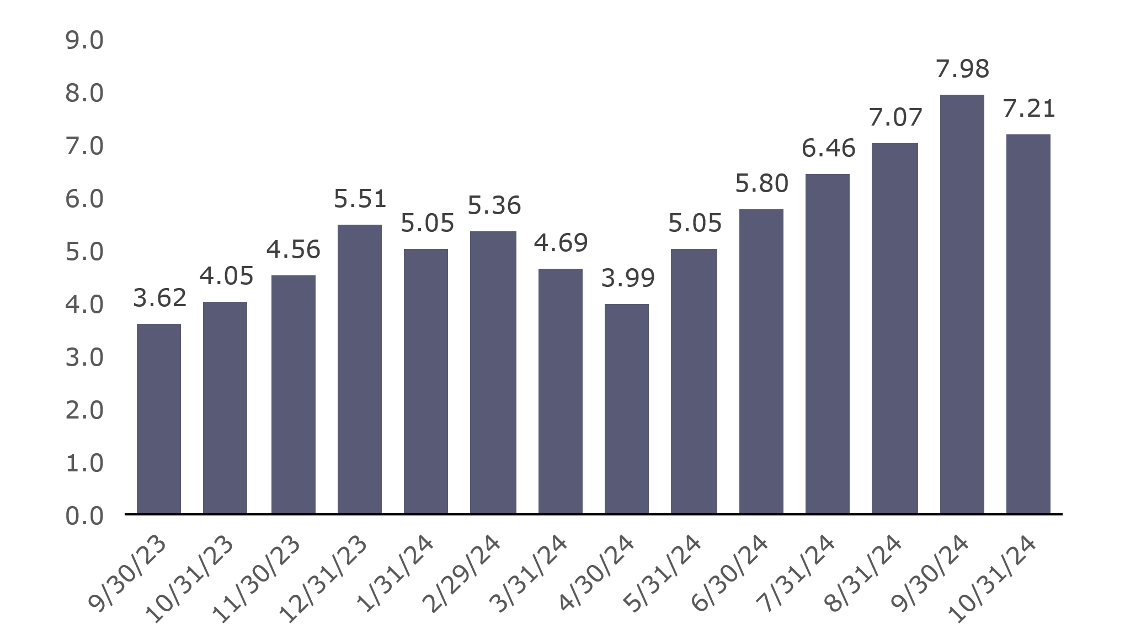
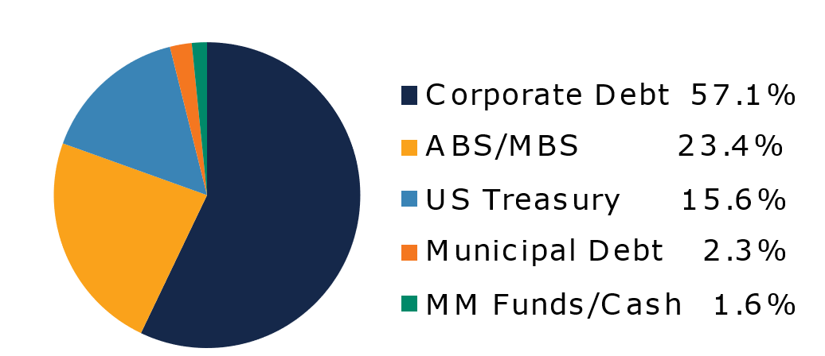
West Virginia
Short Term Bond Pool
Portfolio Overview as of 10/31/2024
Pool Assets
$699 million
The West Virginia Short Term Bond Pool was created to invest restricted moneys of participants which have a longer-term investment horizon. The objective of the portfolio is to earn an incremental return over the WV Money Market Pool with an objective of asset growth rather than current income. The risk factor is higher than the WV Money Market Pool and is managed through numerous maturity restrictions, diversification, guidelines, and credit limits.
Pool Features and Benefits:
Professional management is provided by the West Virginia Board of Treasury investments’ staff and professional investment advisor (Sterling Capital Management). Floating net asset value (NAV). Investment yields are competitive with other short duration fixed income pools. Easy access is provided through the State Treasurer’s Office online system. Account can be opened for as little as $100 with no limit on the number of transactions. Contributions and withdrawals are allowed monthly. Income is distributed on a monthly basis.
Return Summary
To learn how to make the West Virginia Short Term Bond Pool work for your cash investing needs call: 304-340-1564 or visit: wvbti.org
Portfolio holdings and composition are shown as of the date indicated. Since market conditions fluctuate suddenly and frequently, the portfolio holdings may change and this list is not indicative of future portfolio composition. These portfolio holdings are not intended to be and do not constitute recommendations that others buy, sell, or hold any of the securities listed. An investment in the Pool is not insured or guaranteed by any government or government agency and it is possible to lose money by depositing money in the Pool.
Credit Quality Composition (%)
Maturity Schedule (%)
Portfolio Composition (%)
Effective Duration
639 Days
Top Holdings (%)

Slide 2
Board of Treasury Investments | Fact Sheet
Commentary
The month of October kicked off with a surprisingly strong U.S. payroll report showing employers added 254,000 new jobs during the month, more than 100,000 more than economist estimates, while the unemployment rate ticked down to 4.1% from 4.2% previously. Over the following weeks, additional data releases revealed that while inflationary pressures continued to recede, they did so at a slower pace in recent months, indicating that work remains to reach the Fed’s 2% target. Meanwhile, attention remained firmly focused on the upcoming U.S. presidential election, where Donald Trump made modest gains in the polls. The combination of higher odds for a Trump victory, slower progress on inflation and strength in the labor market caused market participants to reduce bets on a more aggressive rate cut cycle from the Fed and pushed short term interest rates sharply higher. For the month, the yield on the two-year Treasury note moved from 3.64% to 4.17%, an increase of 53bps, the largest monthly increase since January of 2023.
Corporate bonds benefitted from the better economic data and the move higher in Treasury yields as demand for risk increased and issuance moderated. Continuing the momentum generated by the Fed’s 50bps rate cut during the previous month, the option-adjusted spread on the Bloomberg U.S. Corporate 1-3Y Index a further 8bps in early October to reach 48bps, its lowest level since early 2022. Net dealer inventories for investment grade bonds spent most of the month in negative territory as dealers struggled to keep bonds on the shelves amidst high demand from retail and institutional buyers. Lighter supply contributed to the bond shortage as issuers brought $95B to market, a sharp decrease from the $167B issued in September.
Performance across the major securitized sub-sectors varied greatly during the month. Agency mortgage-backed securities (MBS) struggled as rates moved higher and buyers stepped away from the market. However, both asset-backed securities (ABS) and commercial mortgage-backed securities (CMBS) performed quite well. ABS issuance reached $309B year-to-date, 31% ahead of last year’s pace and well within the post-financial crisis record of $313B, but the sector still generated 0.25% of excess returns for the month. CMBS excess returns were slightly lower at 0.11%. According to the latest RCA Commercial Property Price Index, commercial real estate prices have remained relatively stable, with a slight decline of 0.56% over the three months ending in September. Central business district office properties continued to lead the decline, while industrial properties remained the best performer, rising 1.3%.
The views expressed represent the opinions of Sterling Capital Management. Any type of investing involves risk and there are no guarantees that these methods will be successful. Data is as of 10.31.2024 unless otherwise stated. Source: Bloomberg L.P. Fed = Federal Reserve. BPS = basis points.

