Slide 1

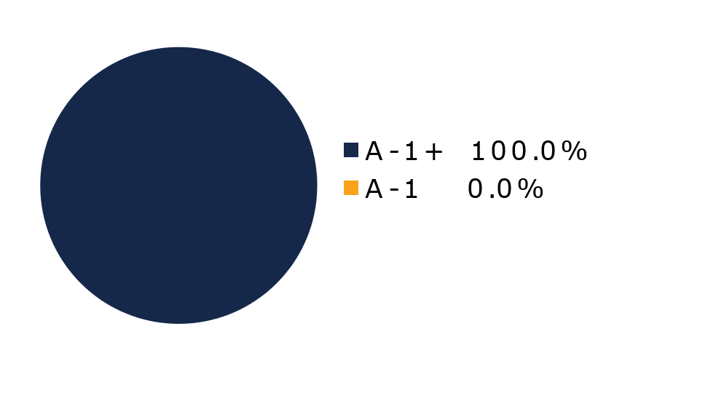
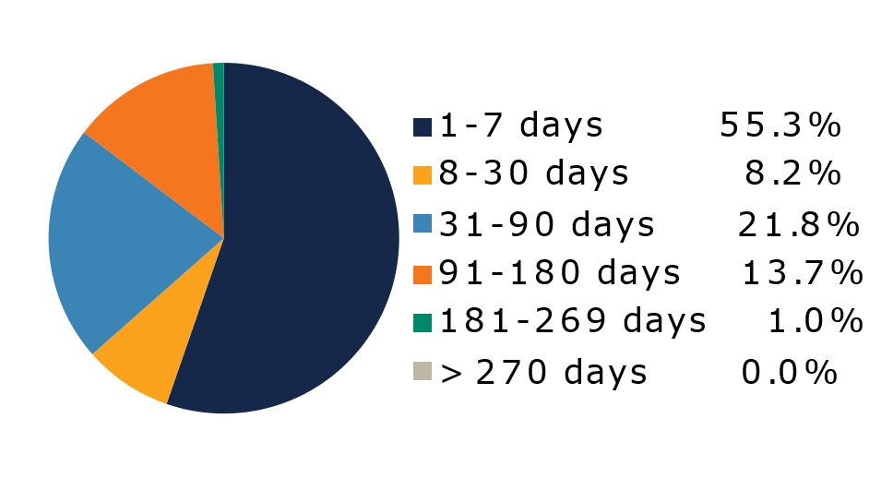
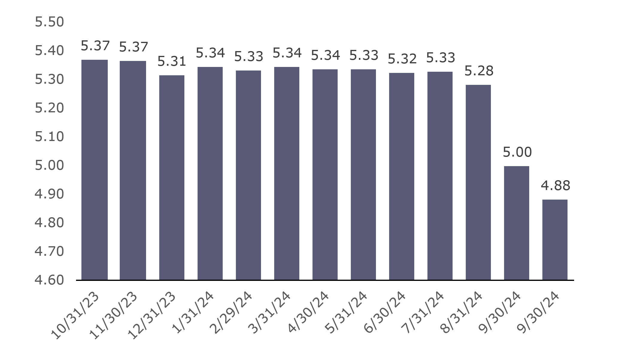
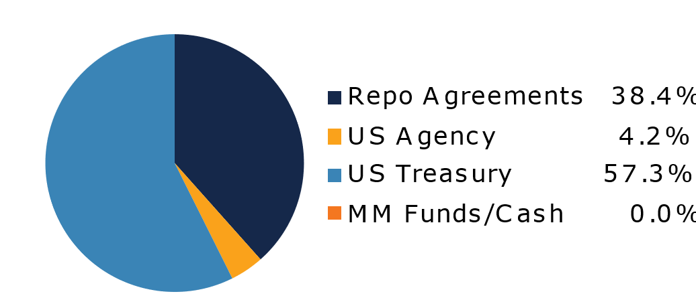
West Virginia Government Money Market Pool
Portfolio Overview as of 10/31/2024
Pool Assets
$564 Million
The West Virginia Government Money Market Pool is a money market portfolio created to invest restricted moneys of participants in US Treasury and US Government Obligations. The objective of the portfolio is to preserve capital and to maintain sufficient liquidity to meet daily disbursements, while earning a return above inflation. The risk factor is low and managed through numerous maturity restrictions, diversification, guidelines, and credit limits.
Pool Features and Benefits:
Professional management is provided by the West Virginia Board of Treasury investments’ staff and professional investment advisors (UBS Global Asset Management). Rated AAAm by Standard & Poor’s. Seeks to maintain a net asset value (NAV) of $1 per share. Investment yields are competitive with other government money market accounts. Easy access is provided through the State Treasurer’s Office online system. Account can be opened for as little as $100 with no limit on the number of transactions. Contributions and withdrawals are allowed daily. Income is distributed on a daily basis.
7-Day Simple Money Market Yield (%)
To learn how to make the West Virginia Government Money Market Pool work for your cash investing needs call: 304-340-1564 or visit: wvbti.org
Portfolio holdings and composition are shown as of the date indicated. Since market conditions fluctuate suddenly and frequently, the portfolio holdings may change and this list is not indicative of future portfolio composition. These portfolio holdings are not intended to be and do not constitute recommendations that others buy, sell, or hold any of the securities listed. An investment in the Pool is not insured or guaranteed by any government or government agency. Although the manager of the Pool seeks to preserve principal, it is possible to lose money by depositing money in the Pool. An AAAm rating by Standard & Poor’s is obtained after S&P evaluates a number of factors, including credit quality, market price exposure and management. Ratings are subject to change and do not remove market risk.
Credit Quality Composition (%)
Maturity Schedule (%)
Portfolio Composition (%)
Weighted Average Maturity
35 Days
Top Holdings (%)

Slide 2
Board of Treasury Investments | Fact Sheet
Commentary
Fuzzy Picture
A common misconception about money market products is that they are only concerned with short-term economic developments because daily liquidity is a defining feature. But cash managers seek to gain higher yields than deposit products by investing across a longer time horizon, often out to a year. Noise in the data and news is no less impactful for liquidity vehicles than it is for bonds and stocks. Well, there’s plenty of that to go around now: the general election, impact of storms, Federal Reserve decisions, interest rates, inflation and more. It reminds me of the television static that used to frustrate viewers of everything from Saturday morning cartoons to the evening news to (most importantly!) sporting events.
The FOMC meeting that ends Nov. 7 is critical for the front end of the yield curve. Intriguingly, the uncertainty here stems as much from the Fed’s 50 basis-point cut in September as it does from parsing of the recent data. While Fed Chair Jerome Powell probably doesn’t have buyer’s remorse, some policymakers seem to regret the magnitude of that reduction, based on the flurry of speeches and appearances since. Yes, the data had softened, and the markets gave them the opportunity for the large cut, but few expected the combination of a rebounding jobs market and sticky inflation. We think voters would like to skip a move next week, but the supersized slash essentially demands they do something to save credibility. But if they do lower the target range by a quarter point, which we expect, they could hold rates steady in December before easing again in January and then continuing that pattern of cut/not cut for multiple meetings.
Determining that won’t be easy. The devastating hurricanes and Boeing strike clouded the October payroll report, which showed the nation added only 12,000 jobs. But the unemployment rate remained at 4.1%, indicating the labor market remains strong. Also, third quarter GDP carried the previous quarter’s banner with solid 2.8% annual growth. The large 3.7% increase in consumer expenditures was an eye-opener. Spending at that level going into the holiday season should support price pressures, which might already have paused their projected descent. The September CPI and PCE reports were little changed from August readings.
The longer the Fed takes to lower rates, the longer yields should remain elevated. Investors seem to be anticipating this. The Investment Company Institute (ICI) reported that U.S. money market funds reached a record $6.51 trillion last month. We estimate the broader liquidity market is following that trend. But it is hard to tell how everything will play out. The sooner the signal improves, the better.

