Slide 1
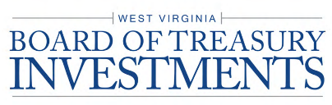
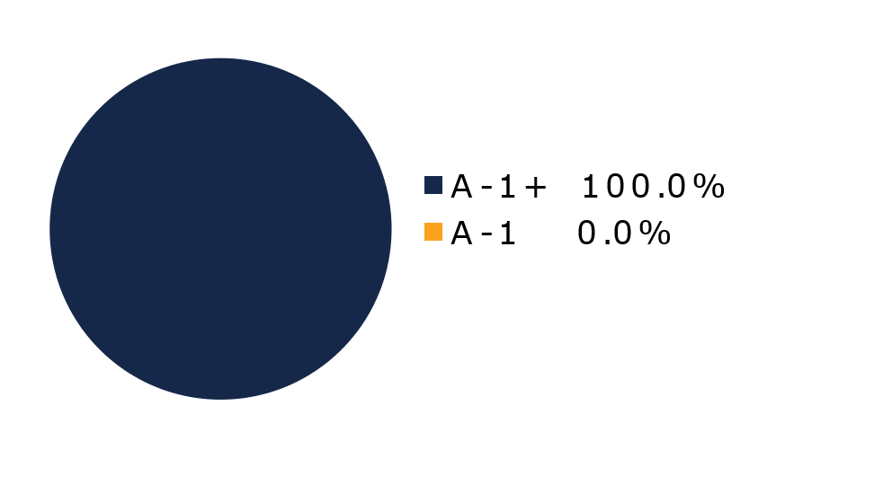
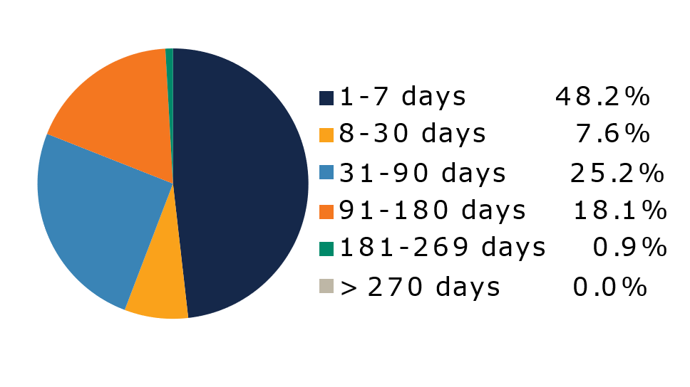
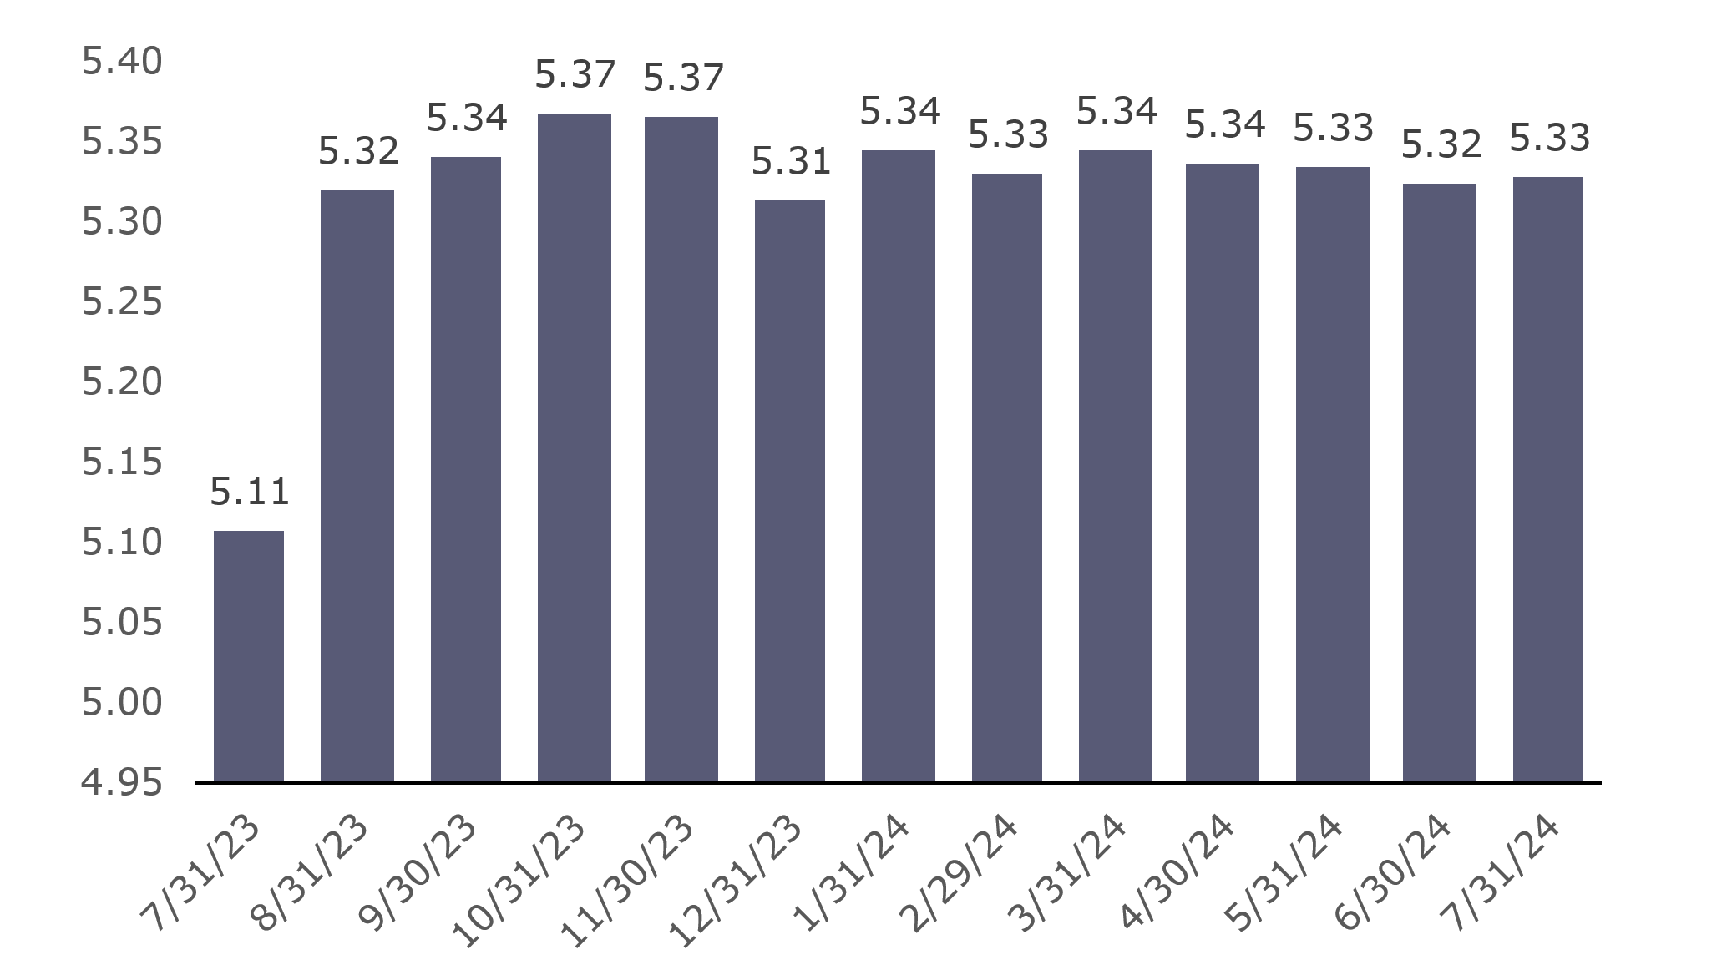
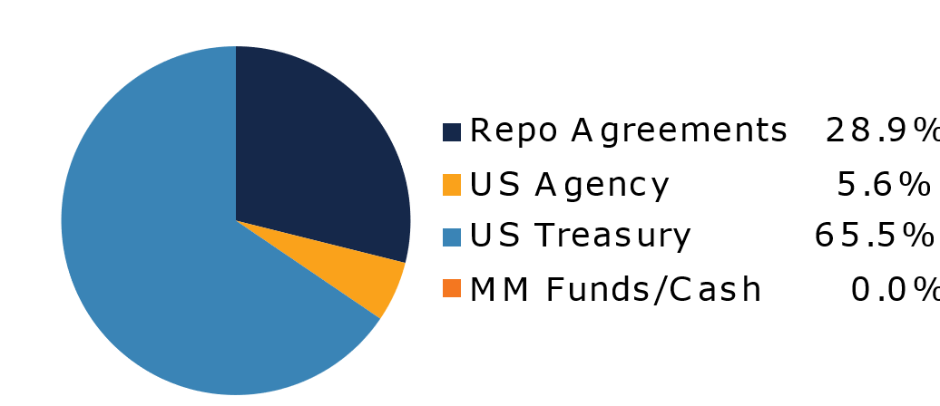
West Virginia Government Money Market Pool
Portfolio Overview as of 7/31/2024
Pool Assets
$524 Million
The West Virginia Government Money Market Pool is a money market portfolio created to invest restricted moneys of participants in US Treasury and US Government Obligations. The objective of the portfolio is to preserve capital and to maintain sufficient liquidity to meet daily disbursements, while earning a return above inflation. The risk factor is low and managed through numerous maturity restrictions, diversification, guidelines, and credit limits.
Pool Features and Benefits:
Professional management is provided by the West Virginia Board of Treasury investments’ staff and professional investment advisors (UBS Global Asset Management). Rated AAAm by Standard & Poor’s. Seeks to maintain a net asset value (NAV) of $1 per share. Investment yields are competitive with other government money market accounts. Easy access is provided through the State Treasurer’s Office online system. Account can be opened for as little as $100 with no limit on the number of transactions. Contributions and withdrawals are allowed daily. Income is distributed on a daily basis.
7-Day Simple Money Market Yield (%)
To learn how to make the West Virginia Government Money Market Pool work for your cash investing needs call: 304-340-1564 or visit: wvbti.org
Portfolio holdings and composition are shown as of the date indicated. Since market conditions fluctuate suddenly and frequently, the portfolio holdings may change and this list is not indicative of future portfolio composition. These portfolio holdings are not intended to be and do not constitute recommendations that others buy, sell, or hold any of the securities listed. An investment in the Pool is not insured or guaranteed by any government or government agency. Although the manager of the Pool seeks to preserve principal, it is possible to lose money by depositing money in the Pool. An AAAm rating by Standard & Poor’s is obtained after S&P evaluates a number of factors, including credit quality, market price exposure and management. Ratings are subject to change and do not remove market risk.
Credit Quality Composition (%)
Maturity Schedule (%)
Portfolio Composition (%)
Weighted Average Maturity
41 Days
Top Holdings (%)

Slide 2
Board of Treasury Investments | Fact Sheet
Commentary
The Fed’s balancing act
One way Federal Reserve leaders stay on message is to repeat words. Chair Jerome Powell certainly does, though sometimes the soundbites come back to haunt him—remember “transitory”? In the last few Federal Open Market Committee meetings, he struck a cadence with “confidence”; at yesterday’s post-meeting press conference, it was “balance.”
The reference was twofold, and amounted to the main news because the Fed, as expected, did not cut rates. The first, related to the Fed's dual mandate, came in his opening remarks: “As the labor market has cooled and inflation has declined, the risks to achieving our employment and inflation goals continue to move into better balance.” In other words, further weakening in U.S. employment is now as important to policy decisions as inflation, which has long been the reason for the tightening cycle.
But Powell also invoked the concept of balance to explain the importance of timing, saying the risks of easing too soon or too late are now essentially symmetrical. Either misstep could damage the economy, respectively sending it into a recession or into a trap in which inflation reaccelerates.
The stakes are high, enough so that it appears the Fed isn’t going to conform to the conventional wisdom that it doesn’t make major policy decisions close to a presidential election to avoid the appearance of political motivation. Powell basically said that if economic reports call for a rate cut in September, they will enact one. In fact, not moving might seem politically motivated. This puts a great deal of weight on his keynote address at the Fed’s annual monetary policy symposium in Jackson Hole, Wyo., later this month.
Not that the fed funds futures market will care. After more-or-less aligning themselves with the Fed’s rate projections over the last several months, traders are now expecting cuts in each of the three remaining meetings this year. They have again become so dovish we should call them by the bird's scientific name, Columbidae Streptopelia risoria. In contrast, we are sticking to our call of only two quarter-point eases this year, with the first likely to come in September.
While monetary policy invites debate and bets, U.S. Treasury Department market action usually doesn't—it comes down to issuance. Its quarterly refunding announcement in May included an estimate of third-quarter borrowing needs. But in late July, it revised that number down by more than $100 billion, reflecting the slower pace of Treasuries rolling off the Fed’s balance sheet. In other news, the Department's recently initiated “buyback” program seems to be going well. The announced plans to engage in “cash-management” buybacks are in addition to the liquidity support ones already underway. These cash-management buybacks may help to smooth Treasury bill issuance over the September corporate tax date.
Global Central Banks
While two major central banks stayed pat in July, four made changes, including one today. Like the Fed, the European Central Bank kept its deposit rate steady (at 3.75%), though leader Christine Lagard said a cut is possible in September. But the Bank of England trimmed rates by a quarter-percentage point today to 5% despite sticky inflation in the UK, and the Bank of Canada cut its benchmark interest rate by a quarter point in July for the second month in a row. It now sits at 4.5%, with officials saying more reductions are likely if inflation cools as they anticipate. The People's Bank of China slightly reduced its overnight rate from 1.8% to 1.7%, its first ease since August 2023. This was a minor surprise, as was news from Bank of Japan (BoJ). Against projections for no change, it hiked rates by essentially a quarter-point, from 0-0.1% to 0.25%, the highest borrowing costs in Japan have been in a decade-and-a-half. The BoJ also revealed it will slow bond buying. Governor Kazuo Ueda’s remarks were dovish, saying that lifting rates again in 2024 is on the table if inflation continues to creep up.

