Slide 1
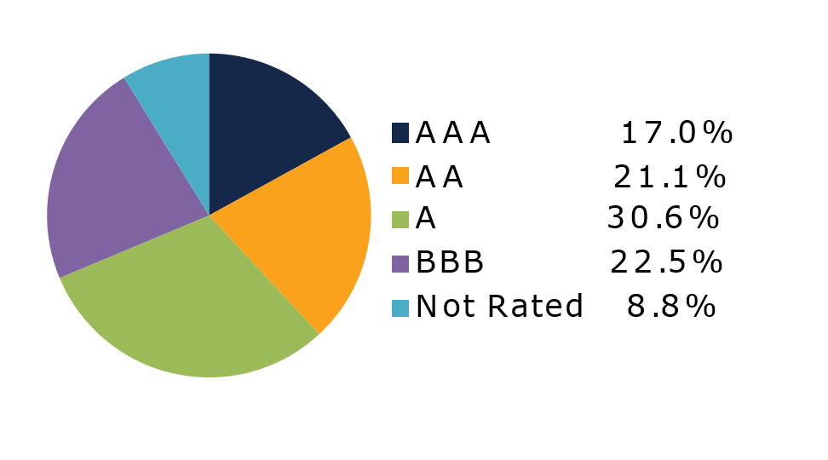
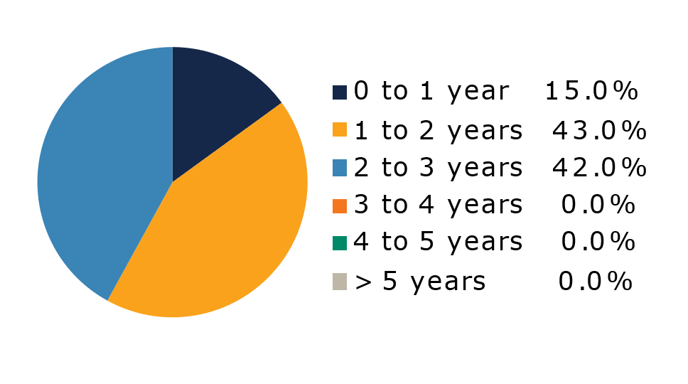
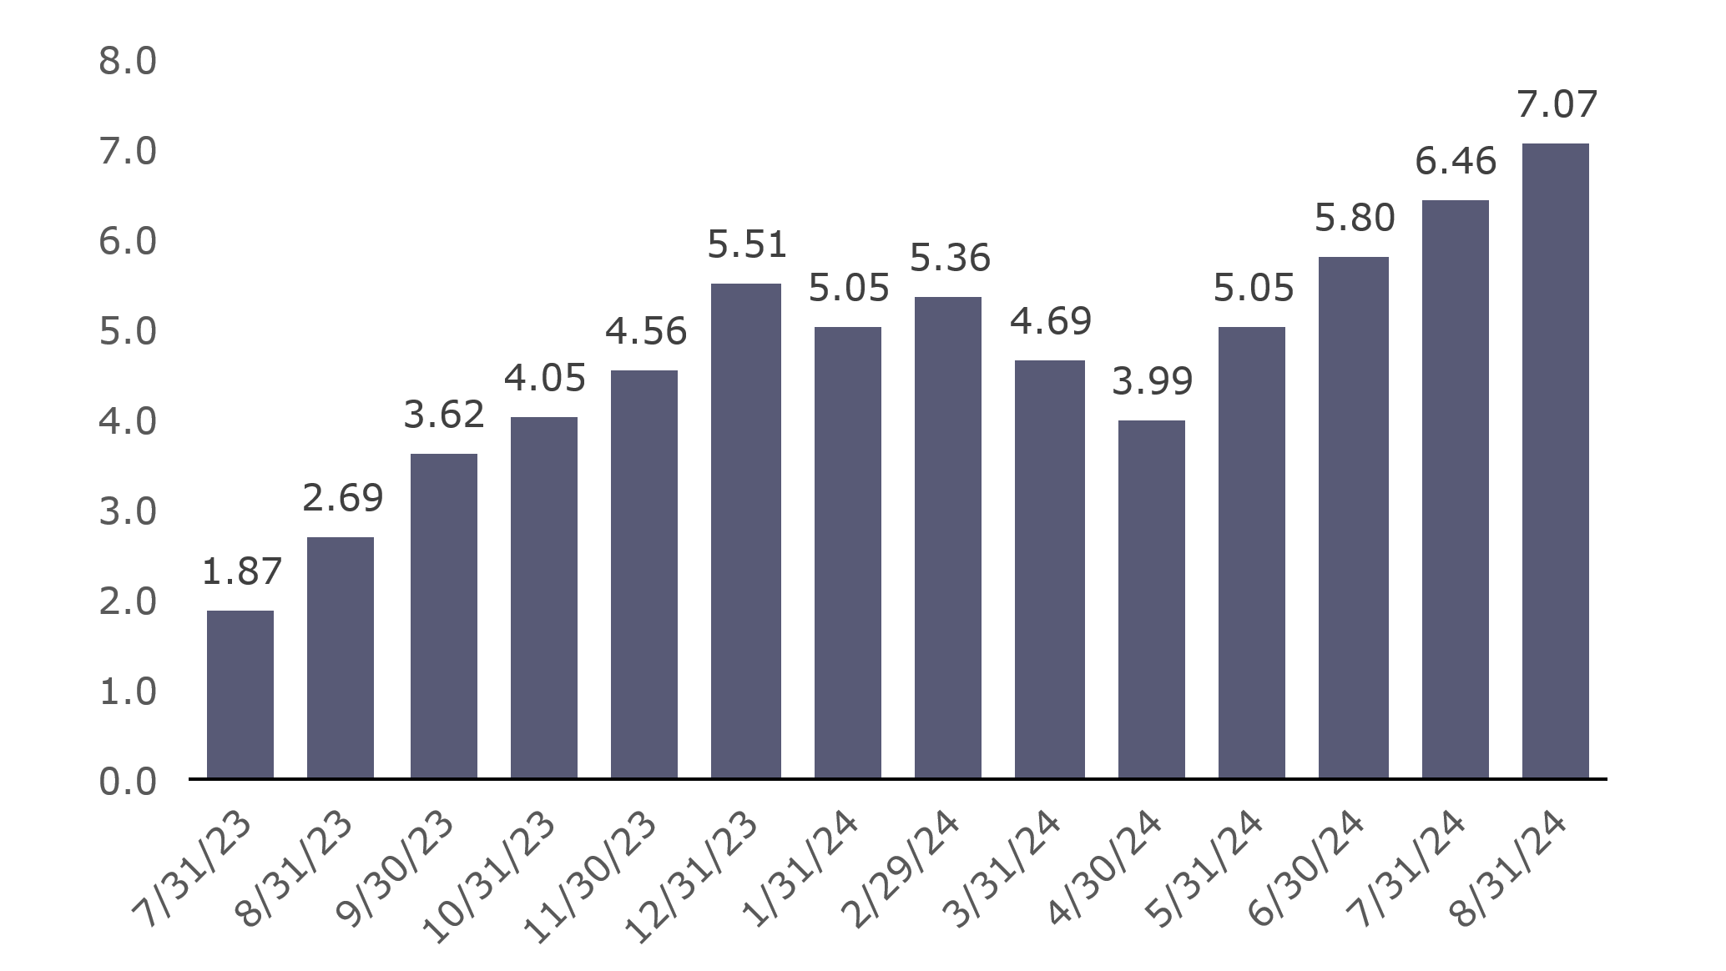
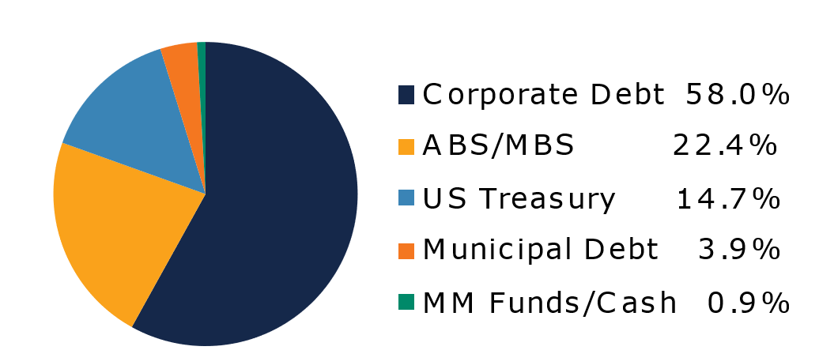
West Virginia Short Term Bond Pool
Portfolio Overview as of 8/31/2024
Pool Assets
$696 million
The West Virginia Short Term Bond Pool was created to invest restricted moneys of participants which have a longer-term investment horizon. The objective of the portfolio is to earn an incremental return over the WV Money Market Pool with an objective of asset growth rather than current income. The risk factor is higher than the WV Money Market Pool and is managed through numerous maturity restrictions, diversification, guidelines, and credit limits.
Pool Features and Benefits:
Professional management is provided by the West Virginia Board of Treasury investments’ staff and professional investment advisor (Sterling Capital Management). Floating net asset value (NAV). Investment yields are competitive with other short duration fixed income pools. Easy access is provided through the State Treasurer’s Office online system. Account can be opened for as little as $100 with no limit on the number of transactions. Contributions and withdrawals are allowed monthly. Income is distributed on a monthly basis.
Return Summary
To learn how to make the West Virginia Short Term Bond Pool work for your cash investing needs call: 304-340-1564 or visit: wvbti.org
Portfolio holdings and composition are shown as of the date indicated. Since market conditions fluctuate suddenly and frequently, the portfolio holdings may change and this list is not indicative of future portfolio composition. These portfolio holdings are not intended to be and do not constitute recommendations that others buy, sell, or hold any of the securities listed. An investment in the Pool is not insured or guaranteed by any government or government agency and it is possible to lose money by depositing money in the Pool.
Credit Quality Composition (%)
Maturity Schedule (%)
Portfolio Composition (%)
Effective Duration
640 Days
Top Holdings (%)

Slide 2
Board of Treasury Investments | Fact Sheet
Commentary
A disappointing U.S. payroll report triggered a surprising bout of volatility in fixed income markets to kick off the month of August. While the data from the Bureau of Labor Statistics showed that U.S. employers added another 114,000 new jobs in the previous month, this figure was 61,000 below the average economist estimate. More importantly, the unemployment rate ticked up to 4.3%, up 0.2% month-over-month and up 0.6% year-to-date. Perhaps more importantly, the move higher in the unemployment rate triggered the so-called Sahm rule, which states that when the three-month moving average of the unemployment rate is 0.5% or more above its low over the prior 12 months, the economy is in the early stages of a recession. Armed with this information and aided by low summertime liquidity, financial markets spent the first few days of the month in a tailspin. Short-term interest rates rallied significantly as a rapid series of cuts in the fed funds rate were priced in while equities and other risk assets sold off. However, markets appeared to find their footing over the subsequent weeks, as other data series revealed that while the economy may be slowing, growth remained positive. In his speech at the Fed’s annual Jackson Hole symposium, Fed Chair Jerome Powell indicated that the Fed was ready to move towards easing monetary policy, likely as soon as their September meeting. The chairman cited progress on inflation towards the Fed’s 2% target and the softening in the labor market as justification for reducing the fed funds rate, and expressed confidence that the economy will avoid recession and achieve a “soft landing.” Although interest rates moved slightly higher after the early rally, yields fell again following Powell’s speech and the two-year Treasury yield closed August at 3.92%, 38 basis points lower for the month.
Corporate bonds and other non-government assets saw risk premia spike higher as volatility took hold early in the month. The option-adjusted spread on short-term corporate bonds widened 17 basis points over the first five days of August to reach their highest level since January. In hindsight, this was a short-lived buying opportunity as investors quickly discounted the odds of a near-term recession. Credit spreads rallied all the way back to within one basis point of their starting point by the end of the month for a positive excess return of 0.05%. While August saw over $100B in new corporate bond issuance, the near-total lack of supply over the last week of the month helped fuel the rally. Agency mortgage-backed securities and non-agency commercial mortgage-backed securities turned in similar performances, outperforming Treasury bonds by 0.07% and 0.08%, respectively. Asset-backed securities, perhaps due to their higher sensitivity to consumer finances and the labor market, underperformed for the month, trailing Treasuries by 0.04%. Finally, although lacking a clear catalyst, short-term taxable municipals turned in a negative excess return of -0.02% for the month.
The views expressed represent the opinions of Sterling Capital Management. Any type of investing involves risk and there are no guarantees that these methods will be successful. Data is as of 08.31.2024 unless otherwise stated. Source: Bloomberg L.P. Fed = Federal Reserve.

