Slide 1

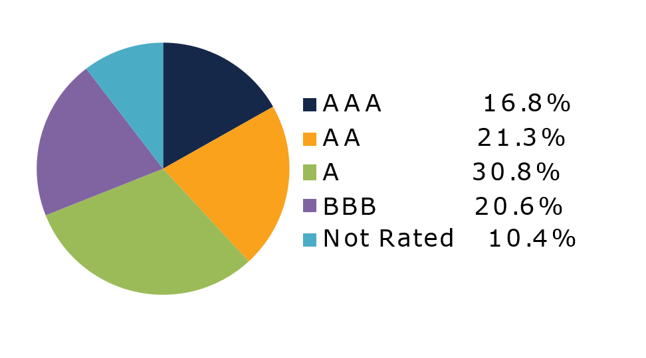
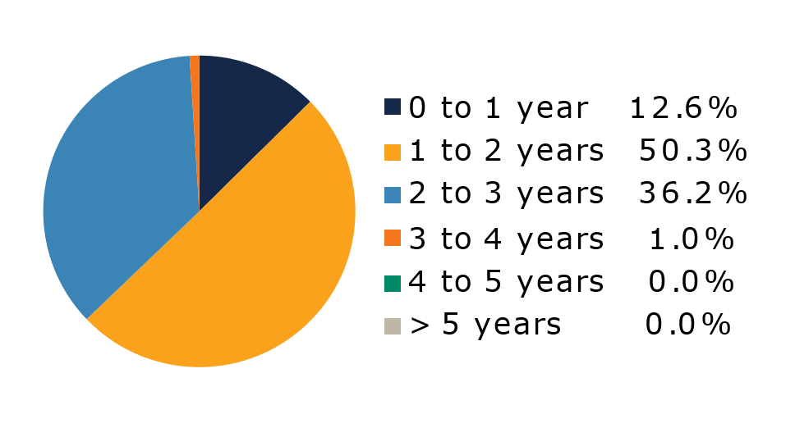
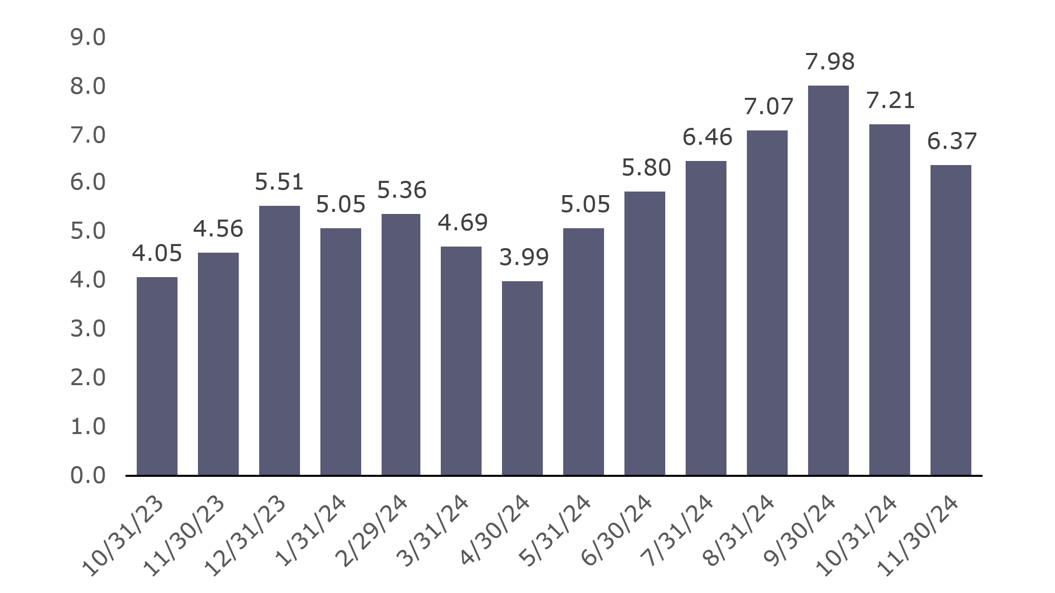
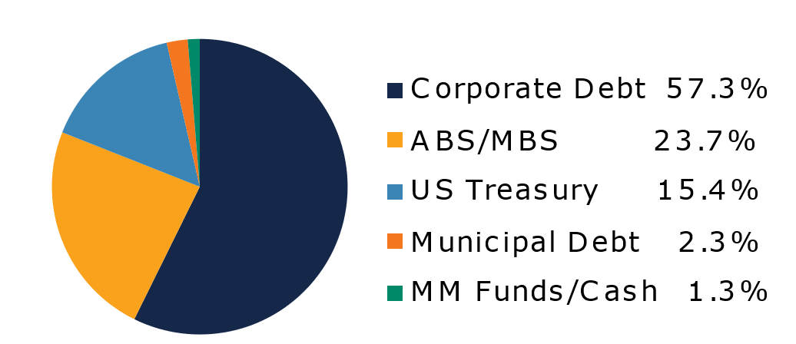
West Virginia
Short Term Bond Pool
Portfolio Overview as of 11/30/2024
Pool Assets
$703 million
The West Virginia Short Term Bond Pool was created to invest restricted moneys of participants which have a longer-term investment horizon. The objective of the portfolio is to earn an incremental return over the WV Money Market Pool with an objective of asset growth rather than current income. The risk factor is higher than the WV Money Market Pool and is managed through numerous maturity restrictions, diversification, guidelines, and credit limits.
Pool Features and Benefits:
Professional management is provided by the West Virginia Board of Treasury investments’ staff and professional investment advisor (Sterling Capital Management). Floating net asset value (NAV). Investment yields are competitive with other short duration fixed income pools. Easy access is provided through the State Treasurer’s Office online system. Account can be opened for as little as $100 with no limit on the number of transactions. Contributions and withdrawals are allowed monthly. Income is distributed on a monthly basis.
Return Summary
To learn how to make the West Virginia Short Term Bond Pool work for your cash investing needs call: 304-340-1564 or visit: wvbti.org
Portfolio holdings and composition are shown as of the date indicated. Since market conditions fluctuate suddenly and frequently, the portfolio holdings may change and this list is not indicative of future portfolio composition. These portfolio holdings are not intended to be and do not constitute recommendations that others buy, sell, or hold any of the securities listed. An investment in the Pool is not insured or guaranteed by any government or government agency and it is possible to lose money by depositing money in the Pool.
Credit Quality Composition (%)
Maturity Schedule (%)
Portfolio Composition (%)
Effective Duration
628 Days
Top Holdings (%)

Slide 2
Board of Treasury Investments | Fact Sheet
Commentary
The deadly storms that ravaged the southeast distorted most of the economic data released during November, putting additional investor focus on the U.S. presidential and congressional elections. Donald Trump’s victory, coupled with very slim Republican majorities in Congress, initially buoyed sentiment as market participants appeared to embrace Trump’s promise of less regulation and lower taxes while acknowledging the potential impacts of more aggressive trade and immigration policies. The FOMC began their November meeting the day following the election and largely kept with expectations by lowering the fed funds rate by 0.25% to a range of 4.50-4.75%. In his press conference, Fed Chair Jerome Powell stated that the FOMC was “feeling good about economic activity” while emphasizing that monetary policy “is still restrictive”. Powell also called out the “unsustainable path” of current U.S. fiscal policy and gave a definitive “no” to a reporting asking if he would resign as Fed chair if asked to by President-elect Trump. While short term interest rates rose leading up to and immediately following Election Day, yields fell in the back half of the month to finish largely unchanged. The two-year Treasury yield ended November at 4.15%, two basis points lower.
Corporate bonds benefitted from the boost in risk appetite that occurred in the immediate aftermath of the elections. The option-adjusted spread on the Bloomberg 1-3Y U.S. Corporate Index rallied seven basis points in just two days to hit 43bps, the tightest level on the index since early 2022, and close the month seven basis points tighter for an excess return of 0.17%. Within the corporate universe, investors chose energy as perhaps the biggest beneficiary of the election outcome, while utilities and finance companies also outperformed.
Securitized assets also saw strong excess returns amidst the risk-on November environment. Despite the initial move higher in interest rates following the election, agency mortgage-backed securities (agency MBS) saw strong demand and spreads moved even tighter as rates fell later in the month as the sector outperformed duration-matched Treasuries by 0.56%. Shorter-duration commercial mortgage-backed securities (CMBS) and asset-backed securities (ABS) also performed well as investors cleared out dealer inventories of asset classes that still looked attractive relative to corporate bonds. CMBS and ABS generated 0.40% and 0.31% of excess returns for the month.
The views expressed represent the opinions of Sterling Capital Management. Any type of investing involves risk and there are no guarantees that these methods will be successful. Data is as of 11.30.2024 unless otherwise stated. Source: Bloomberg L.P. Fed = Federal Reserve. FOMC = Federal Open Market Committee. BPS = basis points.

