Slide 1
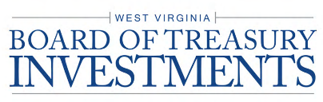
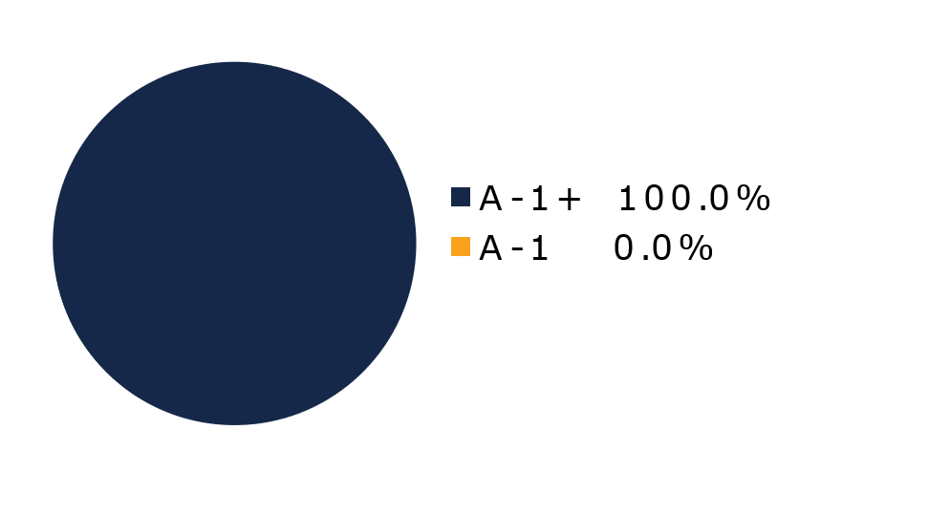
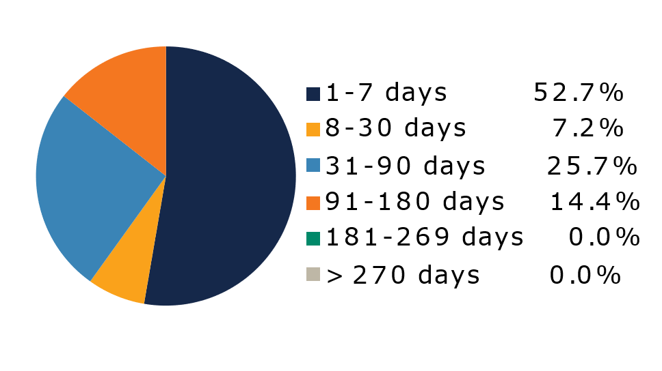
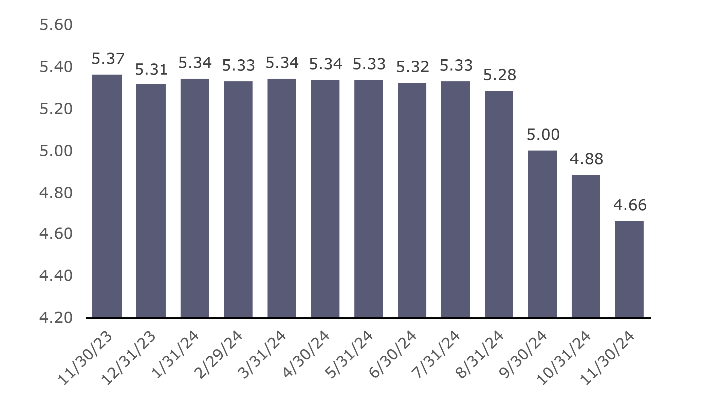
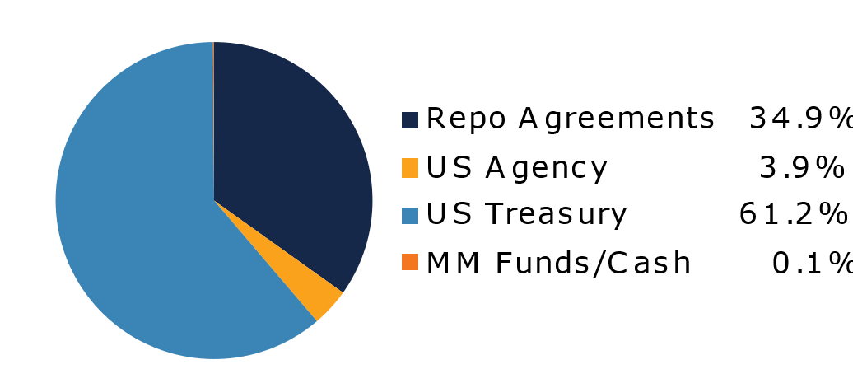
West Virginia Government Money Market Pool
Portfolio Overview as of 11/30/2024
Pool Assets
$545 Million
The West Virginia Government Money Market Pool is a money market portfolio created to invest restricted moneys of participants in US Treasury and US Government Obligations. The objective of the portfolio is to preserve capital and to maintain sufficient liquidity to meet daily disbursements, while earning a return above inflation. The risk factor is low and managed through numerous maturity restrictions, diversification, guidelines, and credit limits.
Pool Features and Benefits:
Professional management is provided by the West Virginia Board of Treasury investments’ staff and professional investment advisors (UBS Global Asset Management). Rated AAAm by Standard & Poor’s. Seeks to maintain a net asset value (NAV) of $1 per share. Investment yields are competitive with other government money market accounts. Easy access is provided through the State Treasurer’s Office online system. Account can be opened for as little as $100 with no limit on the number of transactions. Contributions and withdrawals are allowed daily. Income is distributed on a daily basis.
7-Day Simple Money Market Yield (%)
To learn how to make the West Virginia Government Money Market Pool work for your cash investing needs call: 304-340-1564 or visit: wvbti.org
Portfolio holdings and composition are shown as of the date indicated. Since market conditions fluctuate suddenly and frequently, the portfolio holdings may change and this list is not indicative of future portfolio composition. These portfolio holdings are not intended to be and do not constitute recommendations that others buy, sell, or hold any of the securities listed. An investment in the Pool is not insured or guaranteed by any government or government agency. Although the manager of the Pool seeks to preserve principal, it is possible to lose money by depositing money in the Pool. An AAAm rating by Standard & Poor’s is obtained after S&P evaluates a number of factors, including credit quality, market price exposure and management. Ratings are subject to change and do not remove market risk.
Credit Quality Composition (%)
Maturity Schedule (%)
Portfolio Composition (%)
Weighted Average Maturity
37 Days
Top Holdings (%)

Slide 2
Board of Treasury Investments | Fact Sheet
Commentary
Record High
Records, as they say, are made to be broken. But some seem so out of reach we don’t pay attention to them until they are nearly upon us. Think Cal Ripken’s consecutive games-played streak, Katie Ledecky’s gold medals or LeBron James’ career points. That’s the case with the record amount of money market fund assets under management reached in late November. That number? $7 trillion. The broader liquidity market, including local government investment pools, is also experiencing all-time highs.
Of course, the tremendous inflows started when the Federal Reserve began hiking rates in March 2022 and continued as rates climbed through 3%, 4% and 5%. But with the Fed cutting rates, surely the recent success is coming to an end, right? We don’t think so. A hypothetical theme popular in the markets in the coming months might be that clients can hardly wait to transfer their “sideline cash” to the stock and bond markets if yields dip much further. We believe that for most investors, cash is not coal waiting to be shoveled into a furnace to power riskier asset classes. Liquidity vehicles’ utility as a mechanism to pay expenses with the potential for an attractive return and as a crucial part of a balanced portfolio will persist. If the Fed’s terminal fed funds rate settles in the mid 3s (we now think 3.5% to 4% is possible), cash should remain a robust investment.
Fed and federal
It is still too early to truly assess the ramifications on the liquidity markets of Donald Trump’s return to the White House. We don’t invest based on rumor, speculation or promises. When it comes to the Fed, the Committee’s upcoming decision to lower or maintain the target range is a coinflip. We expect policymakers to adopt an every-other-meeting cut approach in 2025. A pause in December likely means a cut in January; a cut likely means a pause. If policymakers slow the pace of easing due to concerns about inflation stalling or trending back up, money markets likely will see yields stabilize at elevated levels.

